Slide 1
Arts in Healthcare
Transforming health through the Arts

Slide 2
What is Arts in Healthcare
As Defined by the International Society for the Arts in Healthcare:
Therapeutic use of the arts modalities as a means of enhancing the general healing process through connection of the body, mind and spirit as well as through the physiological effects. No interpretation of products or prescription of specific processes

Slide 3
A notion that stands the test of time
In the U.S., surveys show that nearly half of hospitals have arts programs
Programs on every continent
Networks in Australia, Europe, North America, South America, Asia, and Africa

Slide 4
The modern movement
Beginning in the 1970’s, programs were established in US, UK
Started in isolation by committed, visionary individuals
Focus on arts in the hospital environment: architecture, gardens, exhibitions and performances
By the late 1980s programs in the UK and US began to network
By the 1990’s, the Society for the Arts in Healthcare was created, forming the basis for sharing ideas and expanding the notion of arts in healthcare programs.

Slide 5
Shands AIM was created in 1990 by physicians, nurses and artists at Shands, the UF College of Medicine and the Gainesville community
AIM began with two volunteer artists and a small art exhibition program
In 1996, the UF Center for Arts in Medicine was created to work along side Shands AIM focusing on education, research and outreach

Slide 6
Hospital
Environment
Interior design for construction and renovation
Permanent collection acquisition and management
Clinical Environment
Exhibitions
Impact clinical care through the contemplative arts (yoga, meditation, guided imagery)
Artists in Residence & Volunteers
Bedside Practice & Group Sessions
Public Performances
Impact patient care through the creative arts (visual art, literary arts, performing arts)
UF Center for Arts in Medicine
Education
Research
Criser Cancer Resource Center
Outreach
Print and Electronic Resource Libraries
Lending Library
Support Groups
Community wellness Classes
Regional and International Service Learning
Rural and Regional Initiatives
Community Wellness Programs and Partnerships
Staff Wellness Classes
Clinical and Other Studies
Research partnerships
Arts in Healthcare Research Database
Service Learning/Study Abroad
Internship Programs
Training/Certificate Programs
UF Courses

Slide 7
Types of Arts in Healthcare Programs
Environmental Art
Artists in Residence Programs
Performance Programs
Education Programs
Caring for Caregiver Programs
Volunteer Programs
Community Based Arts Programs
Health Literacy
Access to Healthcare
Arts and Healthy Aging

Slide 8
Art in the spaces where care is delivered

Slide 9
Using the arts and design as a fundamental component of the physical condition.
Using paintings, drawings, textiles, photography and sculpture to create spaces of healing
Art work created through artist – patient interactions are used to transform public and clinical areas.
Creating spaces of healing through thoughtful design

Slide 10
Artists in Residence

Slide 11
Artists in Residence Visiting Artists/Residencies Student and Community Volunteers
Professional, paid artists working along side clinical staff at the bedside and in public settings
Performing Arts, Literary Arts, Visual Arts, and Contemplative Arts
Short and long term residencies and visiting artists create a dynamic flow of creative ideas through a program
Volunteers from schools and the community

Slide 12
Engaging Students

Slide 13
Programs designed to enhance the education experience
Students participate in ongoing research projects
Students experience the world through international health programs
89% of the medical schools have extra curricular activities in the arts & humanities
55% of the medical schools students participate in art exhibits
62% of the medical schools students participate in talent shows, 39% in chorales

Slide 14
Caring for the Caregiver

Slide 15
Caring for caregivers includes family, friends, and healthcare providers in hospitals, hospices and other health facilities who are faced with the realities of human suffering, illness and death on a daily basis.

Slide 16
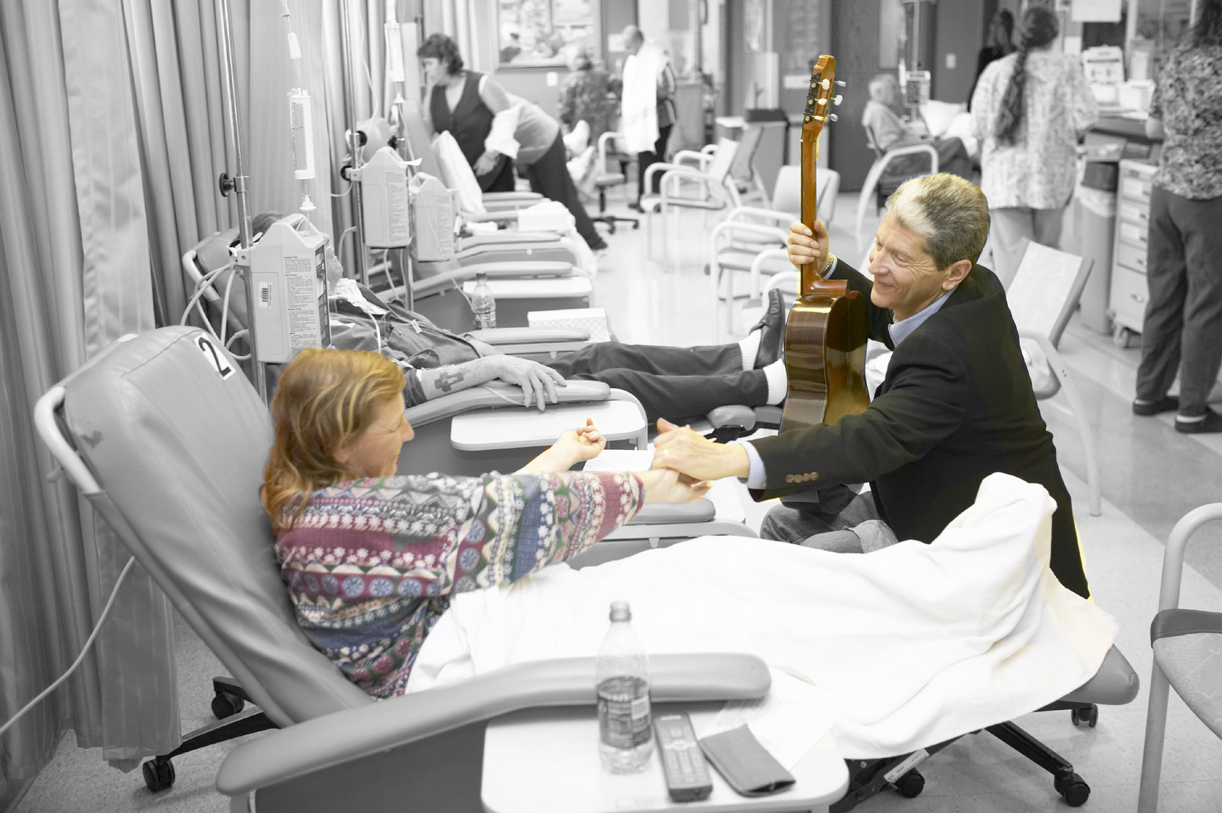
Engaging the Community

Slide 17
Developing partnerships through the arts that promote wellness
That arts are the vehicle that allows us to travel on this common journey – not of illness – but of being human

Slide 18
A vision for the future
Our vision of healthcare in the future includes hospitals that surround it’s patients and staff with creativity in both the arts and sciences - and communities that use the arts to nurture a balanced, healthier, more expressive way of life

